Slide 1

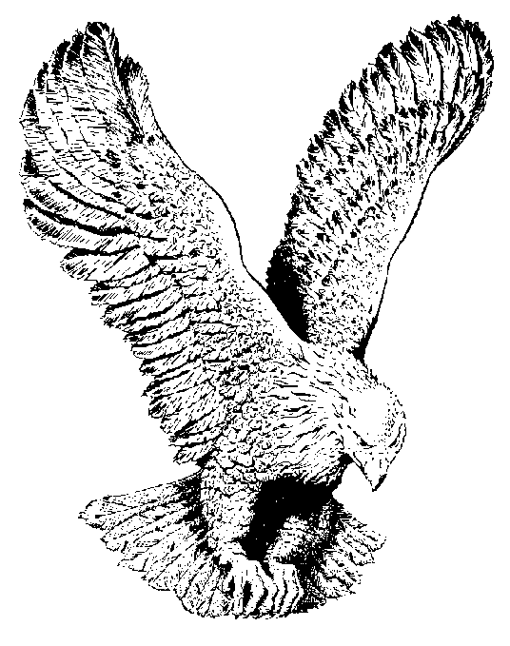
O GLORY TO GOD
O glory to God He lifted me up
He lifted me up I know.
He reached down His hand
And lifted me up
And that’s why I love Him so.

Slide 2
I love Him more and more,
I love Him more and more,
And when I stand upon the other shore,
I’ll praise Him o’er and o’er.

